Slide 1

Copyright © 2005 – 2006 MES-English.com

Slide 2
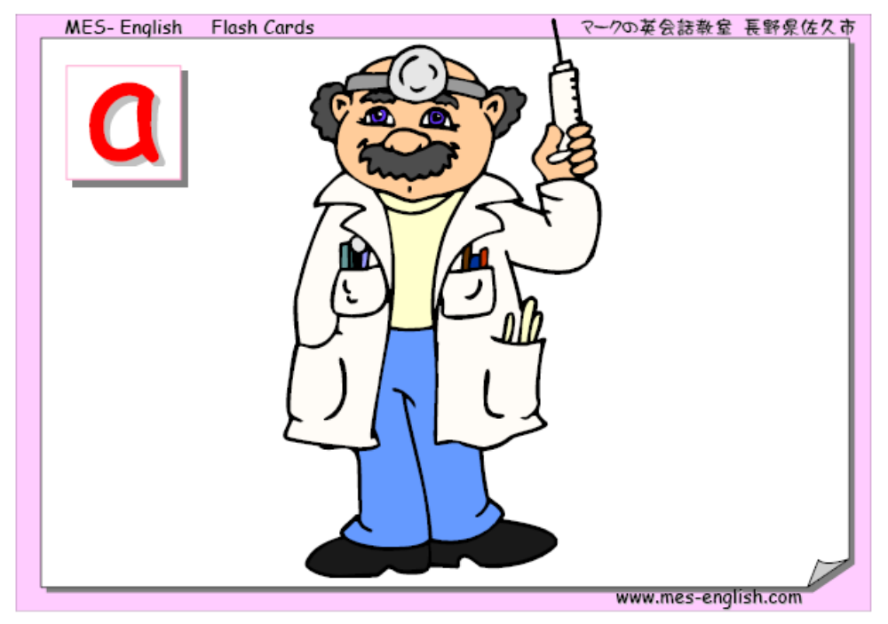
Doctor

Slide 3
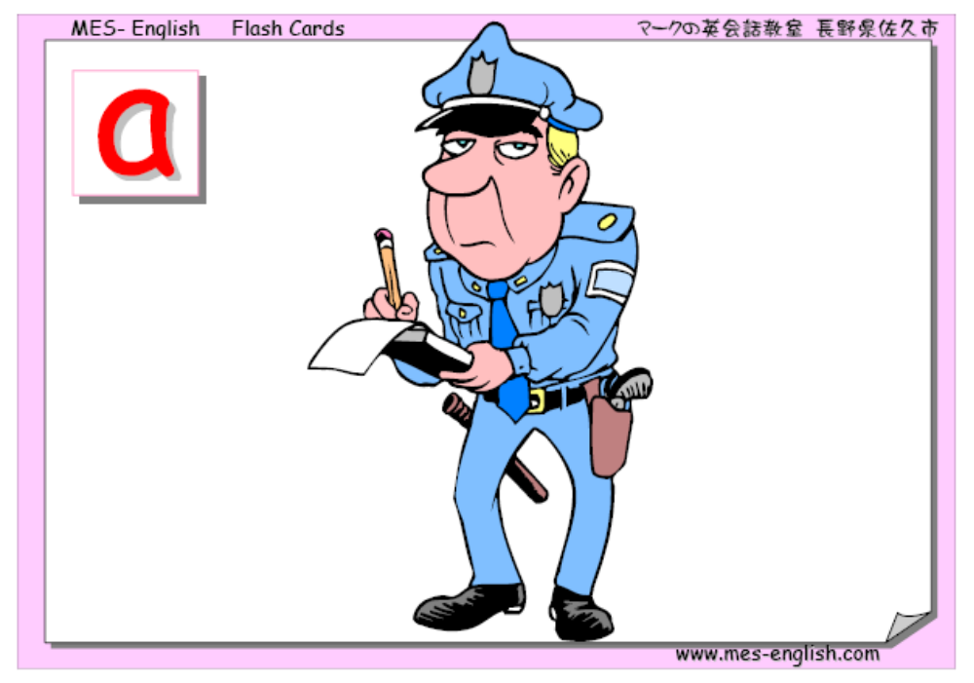
Policeman

Slide 4
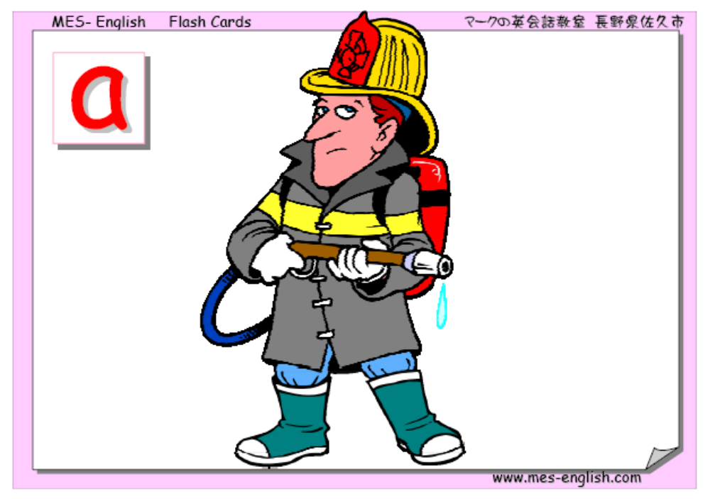
Fireman

Slide 5

Postman

Slide 6
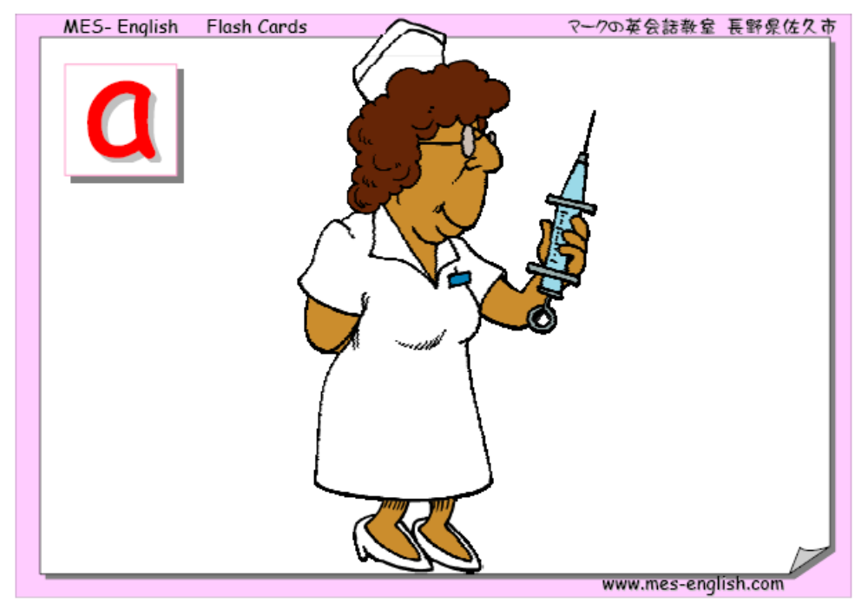
Nurse

Slide 7
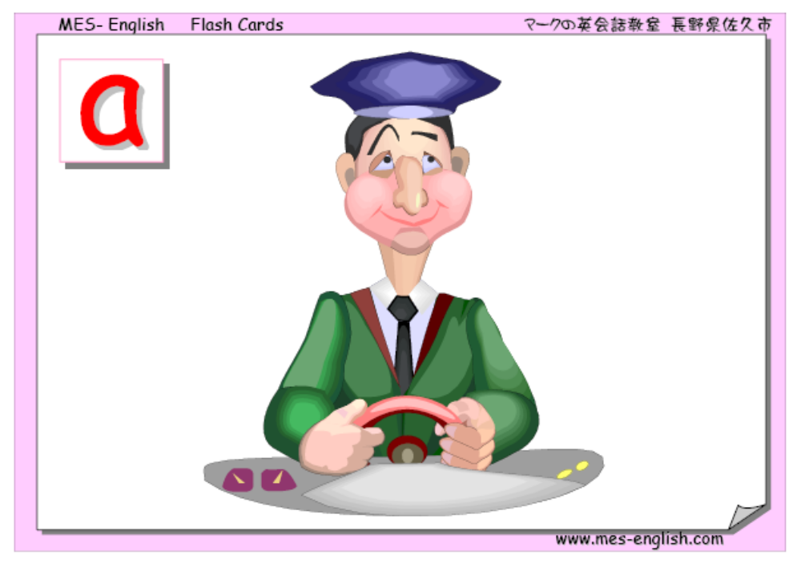
Driver

Slide 8
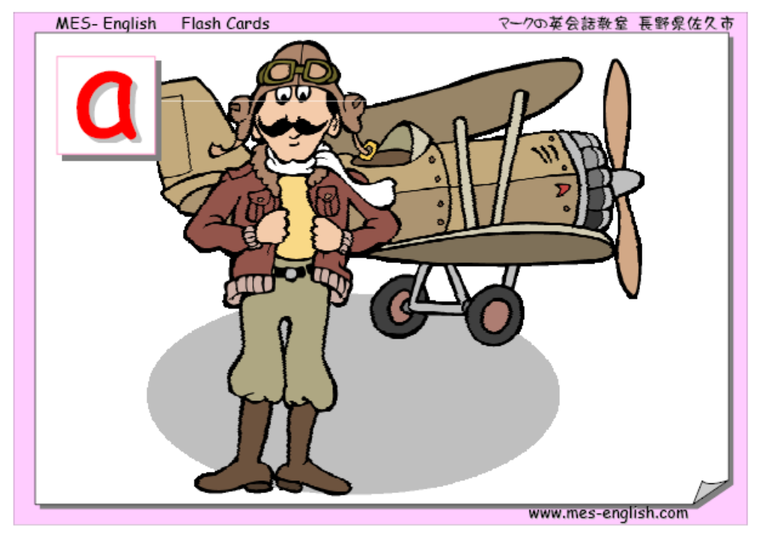
Pilot

Slide 9

Teacher

Slide 10
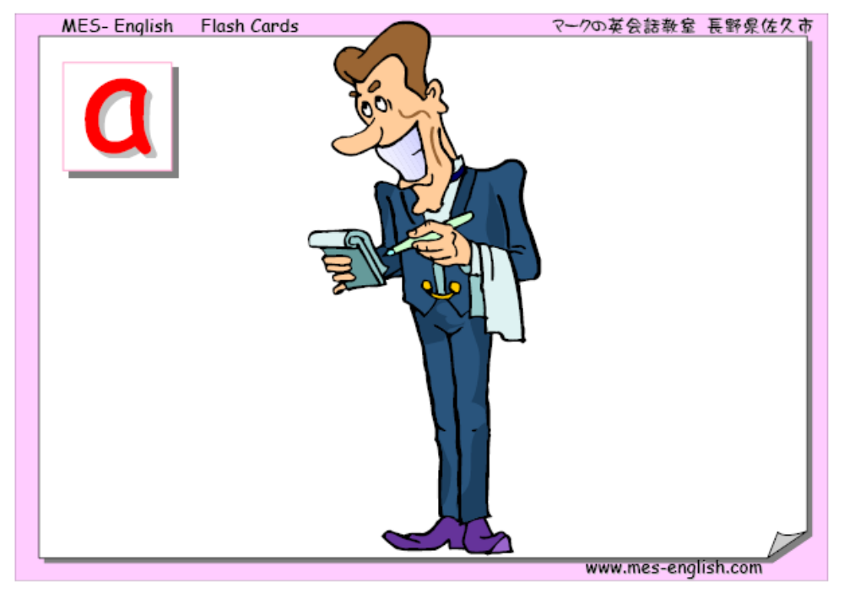
Waiter

Slide 11
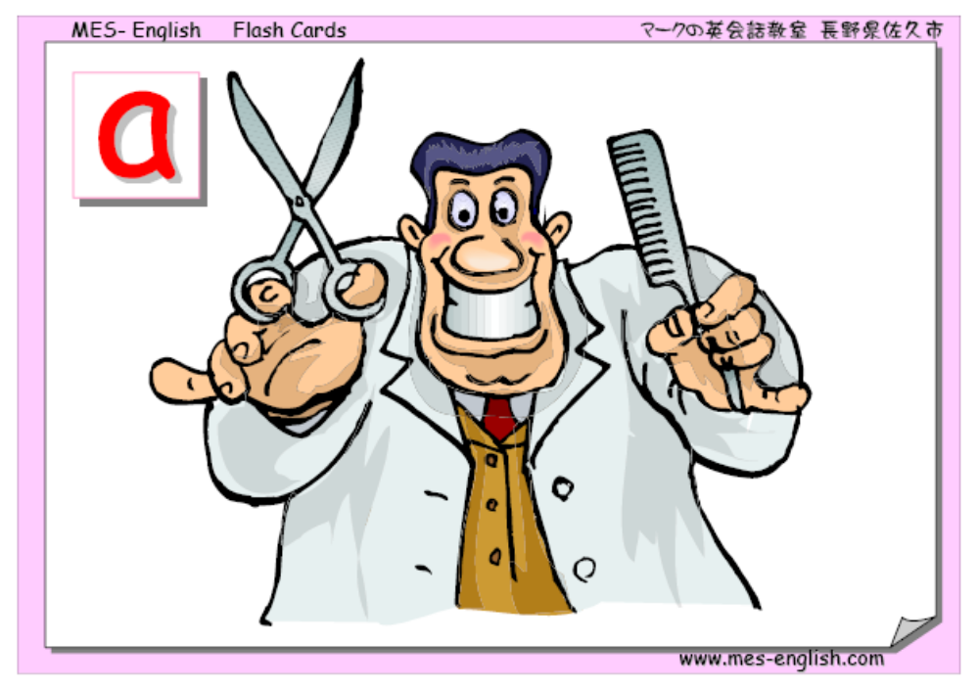
Hairdresser

Slide 12
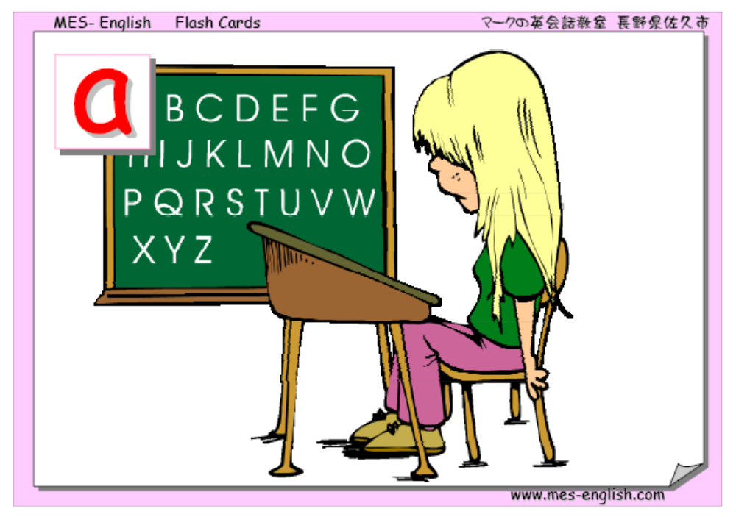
Student

Slide 13
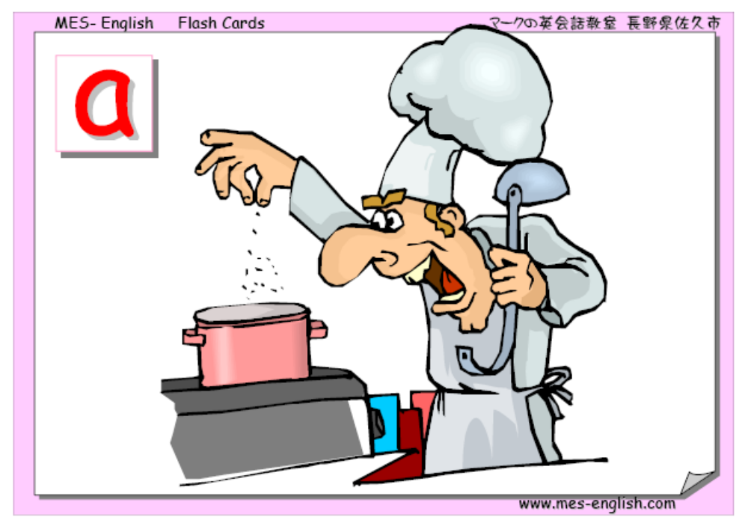
Cook

